Slide 1
Representing data in computers

Slide 2


Binary numbers vs. denary numbers (decimal representation of numbers)
Weighting
The raised number after the various tens/twos are called exponents
Positional notation
A digit’s position determines its weighting
The leftmost bit → the most-significant bit (m.s.b.)
The rightmost bit → the least-significant bit (l.s.b.)

Slide 3

Negative integers in binary
2’s complement system

Slide 4
Fractions in binary
8-bit binary fractions
0.0101000 in binary= ¼+ 1/6 =5/16= 0.3125 in denary
The bits after the binary point in binary fraction are weighted as follows
2⁻¹ | 2⁻² | 2⁻³ | 2⁻⁴ | ...
½ =0.5 | ¼ = 0.25 | 1/8 = 0,125 | 1/16 = 0.0625 | ...

Slide 5
Representing data in the PC

Slide 6
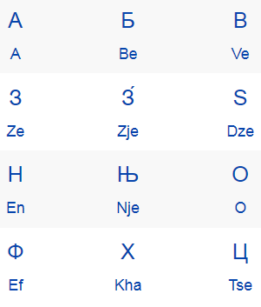
Representing text
ASCII (American Standard Code for Information Interchange)
7-bit code (how many characters or actions can it represent?)
Other than 26 letters?
Cyrillic characters?
Unicode
16 bits, 65000+ characters
Extension mechanism enable additional 1 million Characters to be coded
Notes:
2 to the power of 7 = 128

Slide 7
Representing moving images
Still image as a frame
Pixels (or pels, picture elements)
300 pixels per inch, the size of 2 X 3 inches 256 bit colour picture = 600x900x256 bits = 540 000 bytes
Animations vs. videos
Drawn vs. captured by camera
MPEG (motion picture expert group, a compression technique)

Slide 8
Representing sound
Speech, music...an analogue physical quantity varies with time
Frequency
High/low-pitched sound
Hertz (Hz): ONE cycle per second
Sampling theorem
How often must the sound be sampled?
Frequencies in the sound range from 0 to B Hz, the sound must be sampled at a rate greater than 2B samples per second
MP3 (MPEG-1 Audio layer 3)

Slide 9
Before the Next Session
Print out 4introduction_to_computational_thinking_printable.pdf

